Slide 1

ROCKBUSTER STEALTH LLC
A data-driven approach to streaming service launch strategy
Vasco Fernandes @ Career Foundry

Slide 2


Summary of Rockbuster's Film Catalog DB
958 films
Spoiler Alert
Our customers don't follow this, their real rental durations go from 1 to 10 days. More on this later!
All in English
17 film categories, with balanced spread.
599 customers
in 108 countries
Sports : 73 films
15861 rentals
spread across 100 days
Music : 51 films
3 rental rates:
0.99 - 2.99 - 4.99
5 MPAA ratings, also with balanced spread
PG-13 : 213 films
5 rental durations:
from 3 to 7 days
G : 171 films

Slide 3
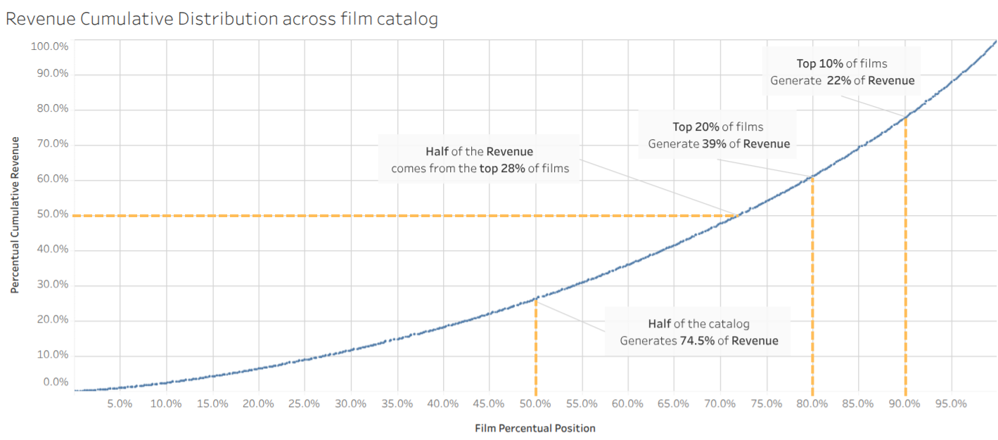
Revenue Distribution

Slide 4
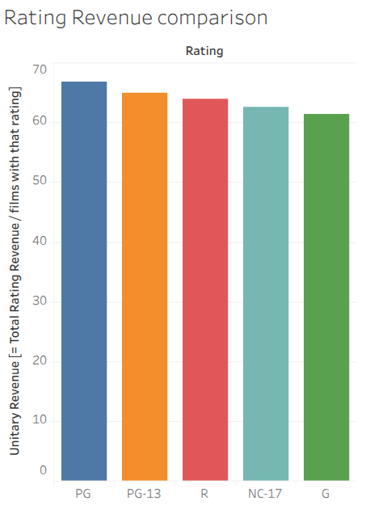
How ratings affect revenue
Comparing ratings measuring revenue per film:
Best rating is PG with $66.9/film
Worst rating is G with $61.5/film
But overall, there is no rating standing out,
with a small spread between ratings

Slide 5
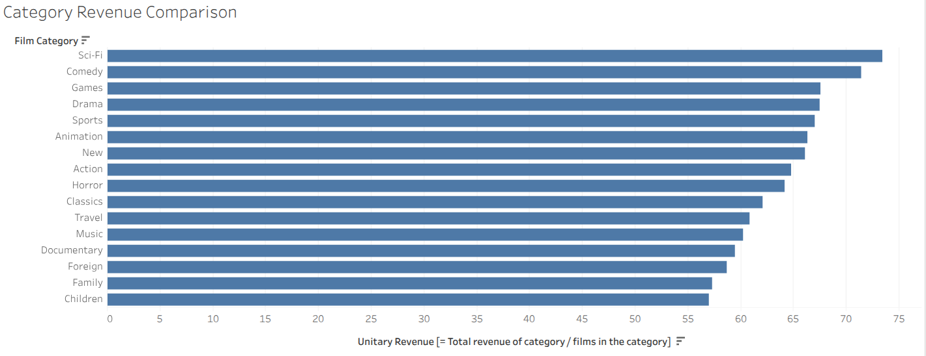
How categories affect revenue
Best categories:
Sci-Fi ($73.5/film)
Comedy ($71.5/film)
The spread between maximum and minimum is $16.4
All categories perform reasonably balanced between each other.
Top 2 categories may deserve special marketing focus.
Worst categories:
Family ($57.3/film)
Children ($57.1/film)

Slide 6
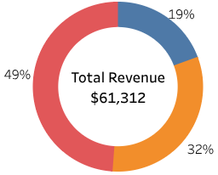
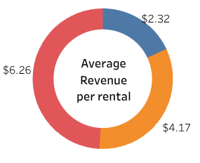

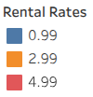

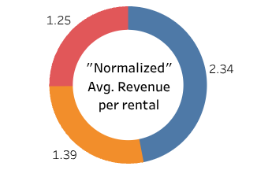
Rental rates performance
Since the total of rentals
for each rate is similar:
Avg. revenue per rental has almost the same distribution
But ..... Shouldn't we expect that $4.99
would be 5 times better than $0.99
If we “normalize” the average revenue per rental, i.e.:
average revenue per rental / value of the rental rate itself
We can quickly see that $0.99 is the one that performs better.

Slide 7
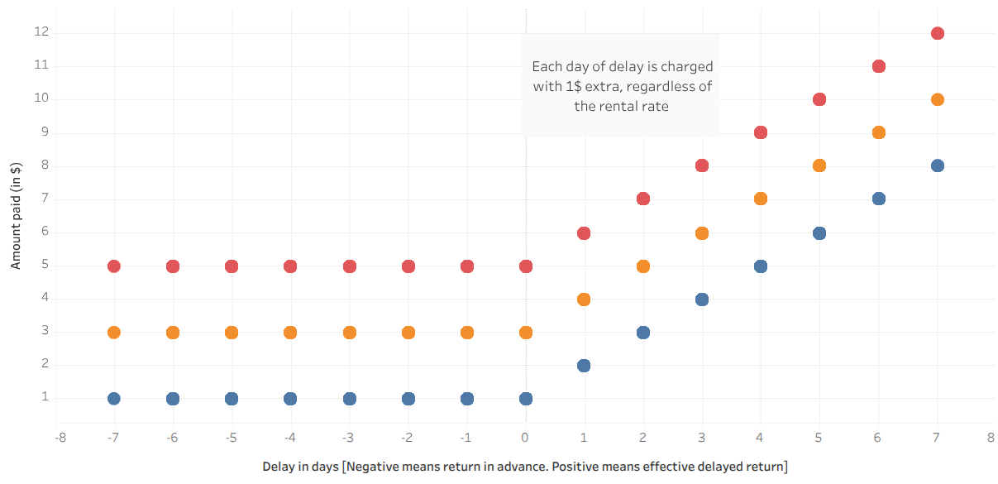
Penalty Policy
The previous result was unexpected. Why does it happen?
The secret lies in the penalty policy.
A fixed surcharge of $1/day ends up benefiting more the lowest rate.

Slide 8
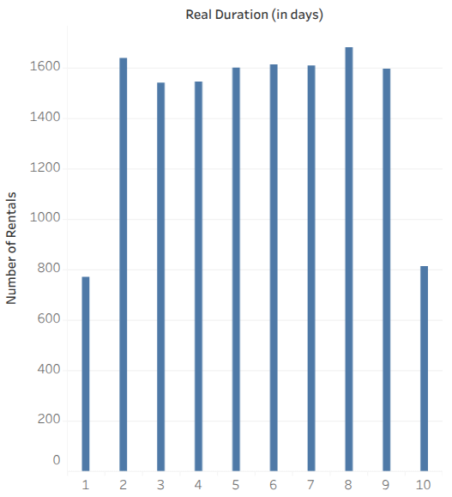
Real rental durations - customers behaviour
Real rental duration was defined as
[rental return time – rental request time]
rounded up in days.
We can observe that:
Extreme values (1 and 10 days) have nearly half of rentals compared to all other durations;
All other durations are well balanced, ranging from 1543 rentals (3 days) to 1682 rentals (8 days)

Slide 9
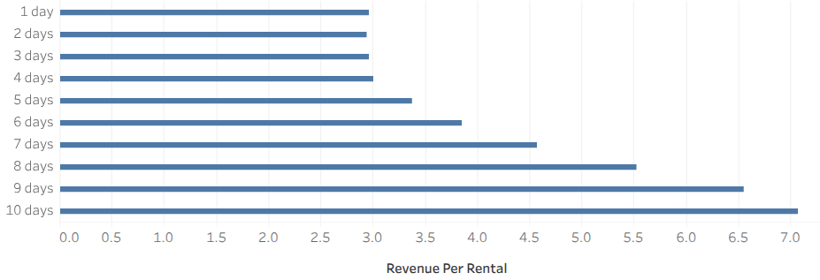
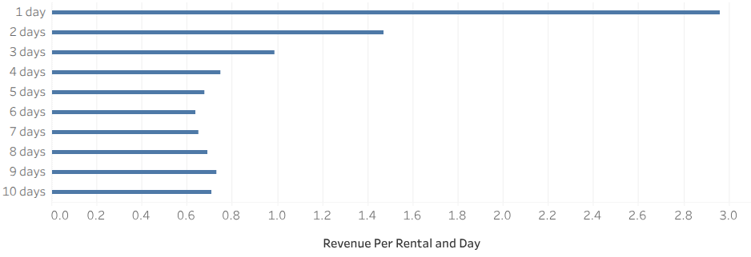
Real rental durations - Revenue
The revenue per rental remains steady until 4 days length, with a value around $3/rental, growing consistently after that until reaching $7.1/rental in 10 days rentals.
If we analyze together with the length of the rental, we have a totally different scenario.
Best performing rentals are short duration ones (3 days or less), with 1 day rentals clearly standing out from all other durations.

Slide 10
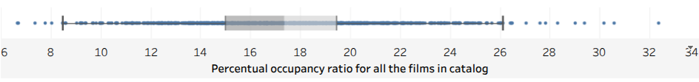
Occupancy Ratio of our Inventory
How much time each film copy is being rented by a customer or standing in our shelves?
To help answer this question, we defined a ratio, called Occupancy Ratio (%), that is calculated as the amount of time where the copies of films are out for rental divided by the total timespan in analysis (approximately 100 days).
Each blue dot of the plot above represent the occupancy ratio of a film. We could observe that:
The median is 17.3%, while the maximum and minimum values are respectively 32,4% and 6,7%
Half of the films (inside the middle gray box) are between 15.0% and 19.5%
Improvements on occupancy ratio is paramount because it's additional revenue without additional cost (or alternatively cost reduction in fewer licenses, to obtain the same revenue)

Slide 11
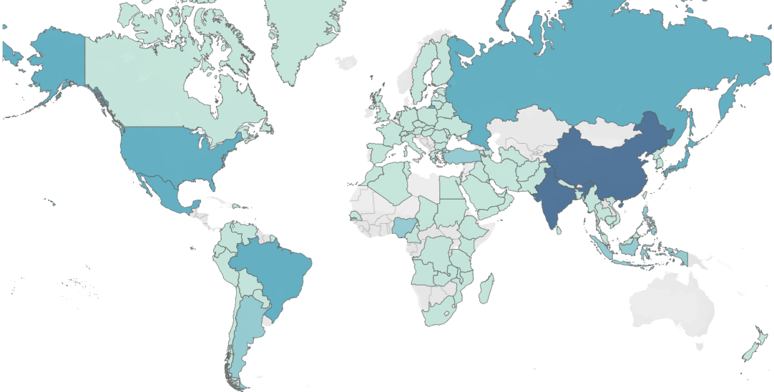


Around the world : our customers
Country | #
India | 60
China | 53
U.S.A. | 36
Japan | 31
Mexico | 30

Slide 12
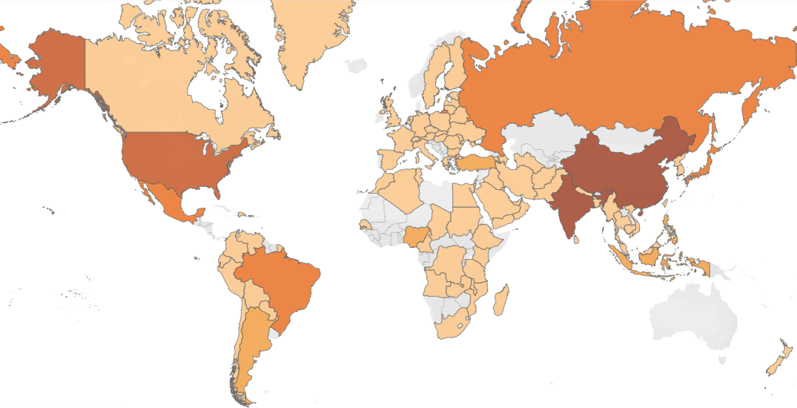

Around the world : our revenue
Country | Revenue
India | $6033
China | $5247
U.S.A. | $3694
Japan | $3122
Mexico | $2985

Slide 13
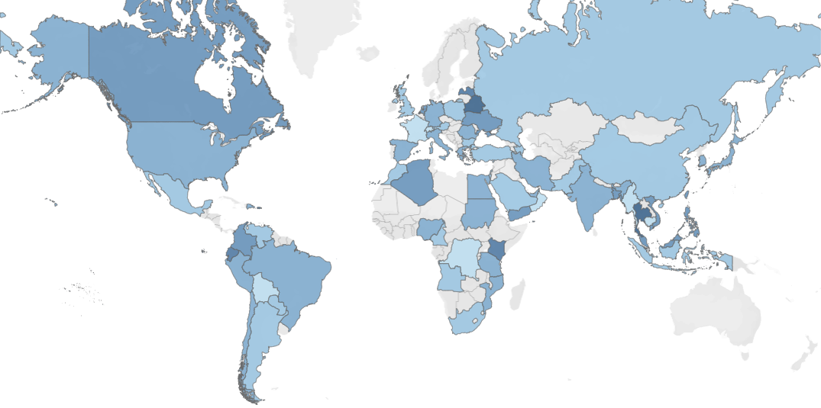

Around the world : revenue per customer
Country | $ /
Belarus | $135.7
Thailand | $133.7
Latvia | $124.7
Ecuador | $123.1
Kenya | $122.8
Note: countries with one single customer were excluded from this view.

Slide 14
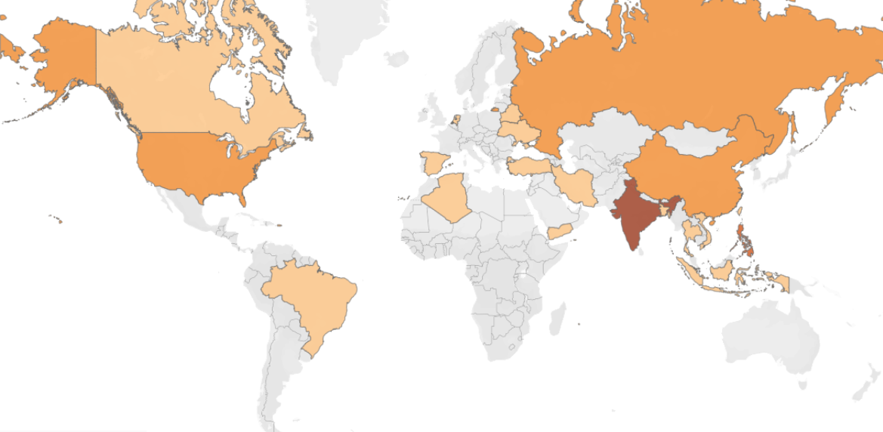

Around the world : top 5% customers
Country | # Top 5%
India | 4
Philipines | 3
Russia | 2
China | 2
U.S.A. | 2
Additionally, other 17 countries have 1 customer each in our top 5%

Slide 15
Recommendations for video rental service launch
Remove variable rental duration concept and apply one single duration for all rentals.
Recommended 48H.
Focus promotional efforts on the top 30% of films.
They represent more than half of the revenue.
Eliminate or review entirely penalty policy:
• Physical return will cease to exist. At best, an extension of digital rental could be in place
• As demonstrated, it makes us lose money in higher rental rate films
Monitor dynamically occupancy ratio to:
• decide when to purchase additional licenses for top requested films
• propose discounted rentals on films with lower occupancy ratio
Focus geographical marketing efforts in the top revenue countries
as well as in the top revenue per customer

Slide 16
Further investigations
Having access to real costs of licensing, a deeper study on profitability can be made.
With a fixed rental period proposed of 48H, it will make more sense to investigate the habits that our customers have in terms of weekdays for their film rentals.
THANK YOU
For any questions, please contact: neves.fernandes@gmail.com

